Slide 1
Cultural Artifacts:
Miguel Luciano, Puerto Rican artist

Slide 2
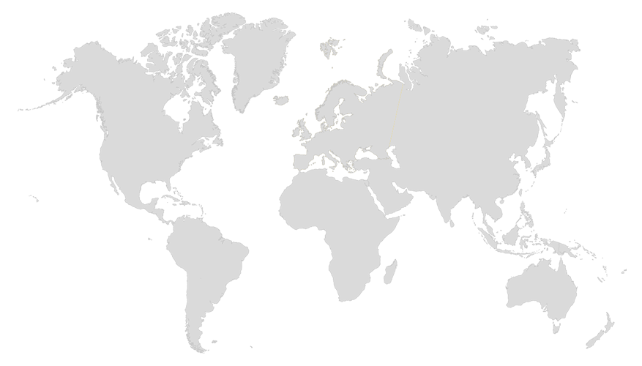
Where in the World is Puerto Rico?

Slide 3
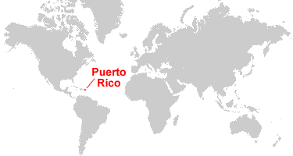
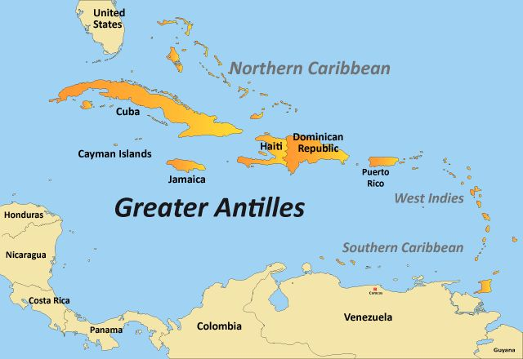
Where in the World is Puerto Rico?

Slide 4
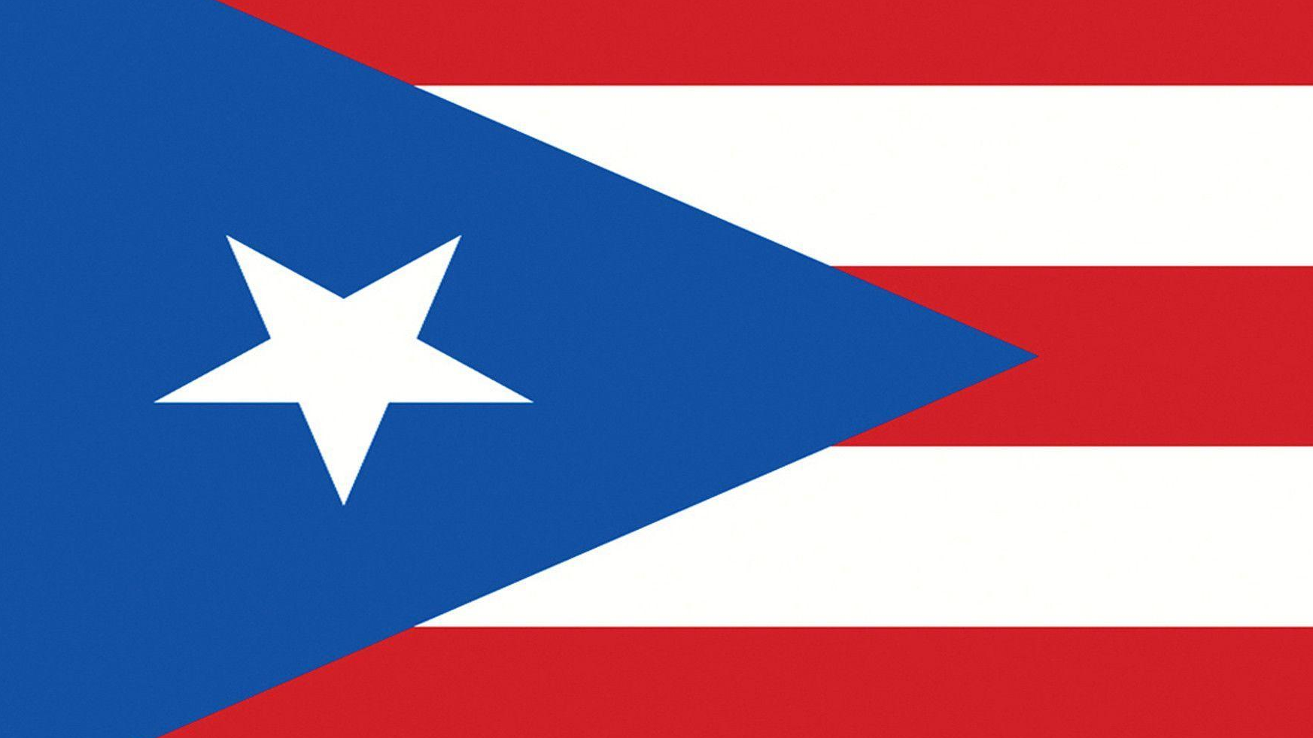
Puerto Rico Facts
Official Languages: Spanish and English
3.6 million people living in Puerto Rico
5 million Puerto Ricans living in the U.S.A.
Rich history and culture.
Notes:
Facts From: Facts about Puerto Rico | Discover Puerto Rico

Slide 5
Puerto Rico Facts
The country of Puerto Rico is a United States Territory.
People in Puerto Rico are United States citizens.
Cannot vote for U.S. president.
Do not having voting power in Congress.
Notes:
Facts From: Facts about Puerto Rico | Discover Puerto Rico
What Does Being A U.S. Territory Mean For Puerto Rico? : NPR

Slide 6
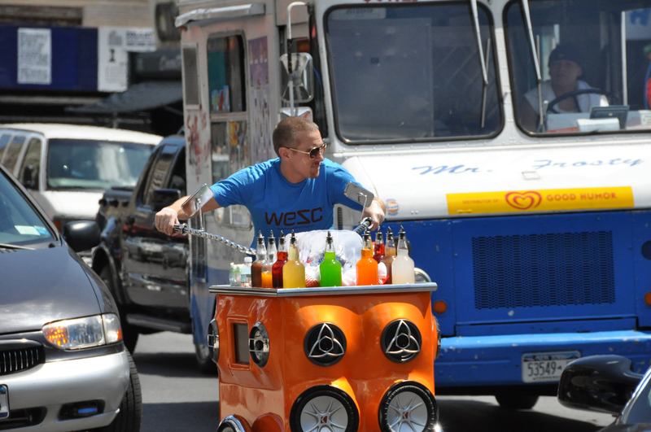
Discussion Questions
What do you see in this picture?
Have you ever seen something like this before?
What could this be used for?
Notes:
Miguel Luciano: Pimp My Piragua

Slide 7
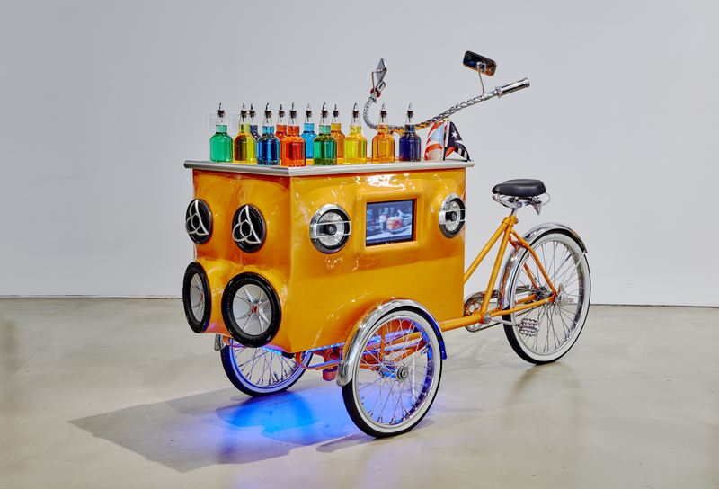
Title: Pimp my Piragua (2008-2009) Artist: Miguel Luciano
Notes:
Miguel Luciano: Pimp My Piragua

Slide 8
What is a “piragua”?
A piragua is shaved ice that is sold mostly by pushcarts in Puerto Rico.
How is Luciano’s piragua bike different from the one in the video?
Notes:
Video link: Piragua - Full Clip - In the Heights 2021 – YouTube
Stop video at 1:10

Slide 9
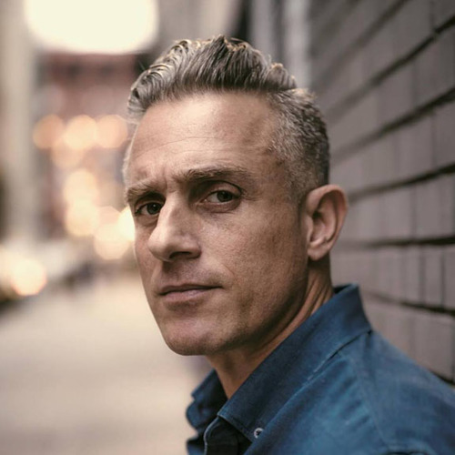
Artist: Miguel Luciano
Miguel Luciano is a multimedia visual artist whose work explores themes of history, popular culture, social justice and migration, through sculpture, painting, and socially engaged public art projects.
Born in Puerto Rico and lives in New York.
Notes:
Miguel Luciano: Bio

Slide 10
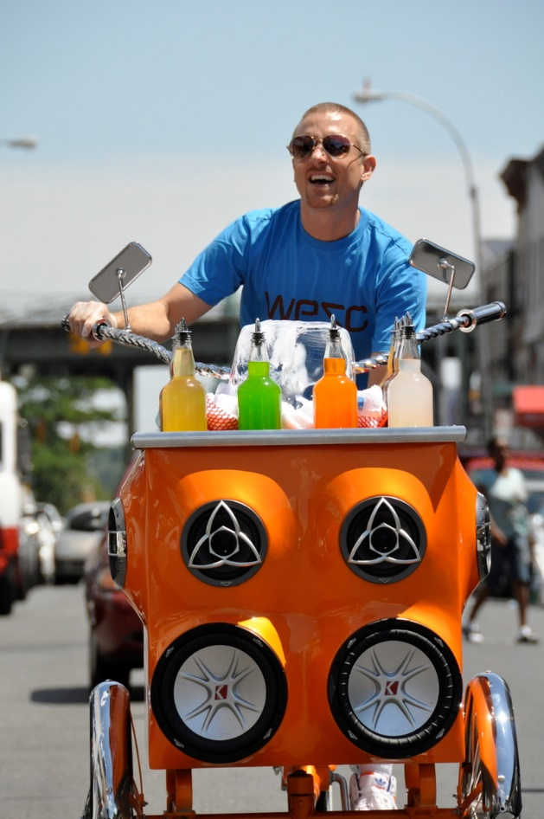
What is a piragua?
A piragua is shaved ice that is sold in pushcart in Puerto Rico.
How is Luciano’s piragua bike different from the one in the video?
Luciano’s piragua is “pimped out” and has a hi-fi sound and video system!
Notes:
Video link: Piragua - Full Clip - In the Heights 2021 – YouTube
Stop video at 1:10

Slide 11
As you view, keep in mind…
Briefly summarize what a “piragua” is according to Miguel Luciano.
Why do you think piragua carts were used and not ice cream trucks?
How is Luciano’s piragua cart different from traditional piragua carts?
Why do you think the artist created and performed in a piragua cart as artwork?
Notes:
Ask students to keep these questions in mind as they view.

Slide 12
Video
Notes:
Video Link:
Miguel Luciano Talks Puerto Rican Bike Clubs, Bike Culture, and the "Ride or Die" Exhibit | BK Live – YouTube
Start video at: 5:10
End Video at: 9:30

Slide 13
Video Discussion Questions
According to Miguel Luciano, what is a “piragua”?
Why do you think piragua carts were used and not ice cream trucks?
How is Luciano’s piragua cart different from traditional piragua carts?
Bikes are an item of popular culture. What is another item of popular culture?
Is there an item in your culture like the piragua? If so, what is it?

Slide 14
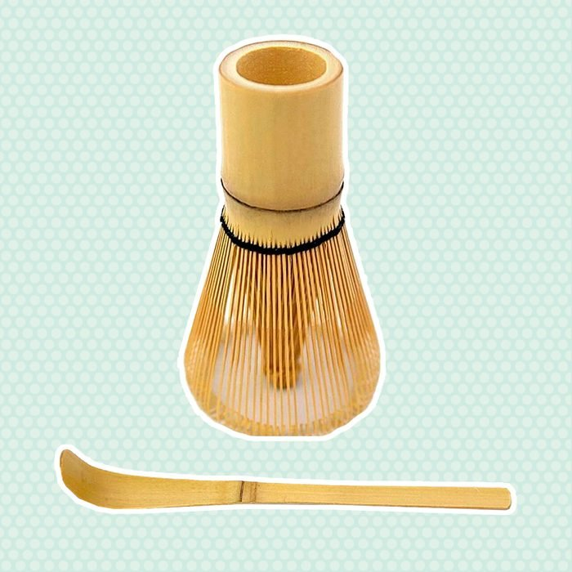
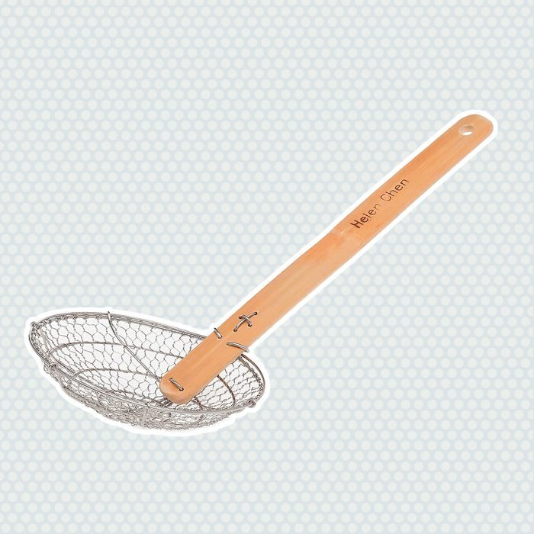
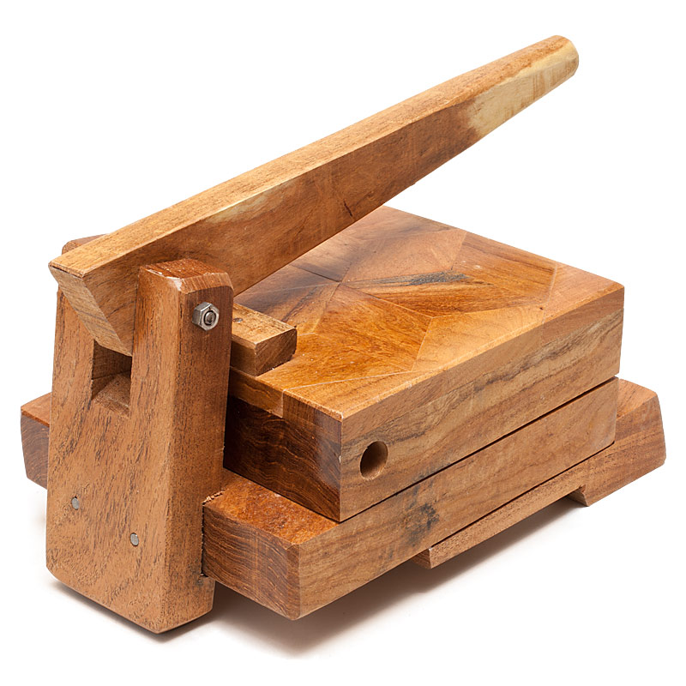
What item is unique to your culture?
Think about an item in your culture like the piragua cart.
Notes:
10 Unusual Kitchen Tools from Around the World | Taste of Home

Slide 15
What item is unique to your culture?
Think about an item in your culture like the piragua cart.
How are those items used?
How are they unique to your culture?
How could you “pimp” that item and make it flashier, more modern?
Notes:
10 Unusual Kitchen Tools from Around the World | Taste of Home

Slide 16
Final Reflection
How do cultures impact the things we use?
How about the things our community uses?

Slide 17
Art Activity: Two options!
Write a 300-word essay about an item in your culture that you use at home or see in your community. Describe its function in your culture or community. [If you can’t think of an item, research about a culture you are interested in and find an item to write about.]
Create a “pimped out” version of your item using things from around your house. The item must still be usable and must function, just like the piragua cart!

