Slide 1
Working and Waiting in Nigeria:
Using David Claerbout’s Art to Explore Nigeria’s Petroleum Industry

Slide 2
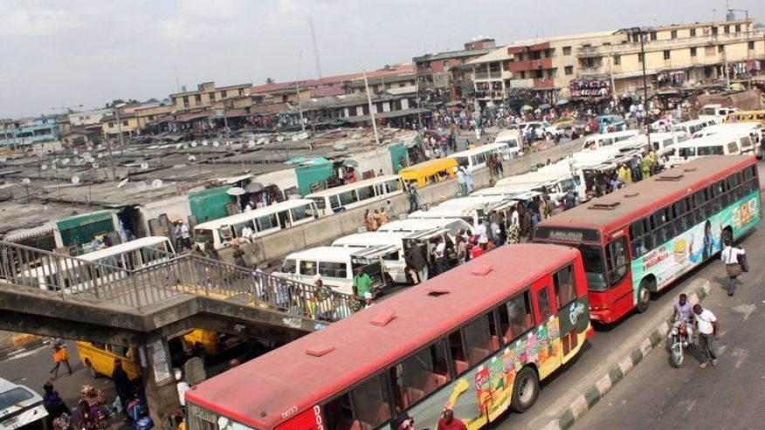
Buses near a market in Lagos, Nigeria
Notes:
Source: Agence France Presse, https://www.afp.com
Caption: Buses are seen near a market in Lagos on February 1, 2012. Long queues have formed at petrol stations in some Nigerian cities after a key oil workers union ordered a three-day strike to demand better conditions and road repairs. (AFP/File)

Slide 3
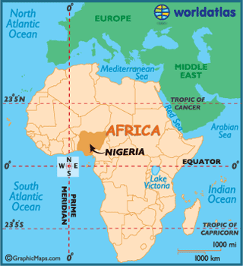
Nigeria: Essential Facts
Africa’s most populous country (186 million people)
Located in West Africa
Colonized in late 19th century by Great Britain
Became independent in 1960
Capital is Abuja
Notes:
Information source: Science Kids, http://www.sciencekids.co.nz/sciencefacts/countries/nigeria.html
Map source: World Atlas.com, http://www.worldatlas.com/img/areamap/7457de7b64ef4b7b0860059b4bfab7fe.gif

Slide 4
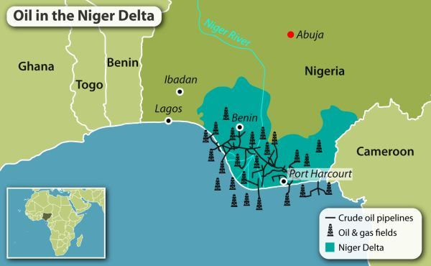
Notes:
Source: https://www.gisreportsonline.com/nigerias-oil-reform-faces-steep-hurdles,energy,1822,report.html
Point out the capital of Nigeria, Abuja and where the oil and gas fields are located.
The oil producing Niger Delta region brings about 90 percent of foreign exchange earnings and 80 percent of Nigeria’s federal government revenues.
In 2010, the U.S. was the main buyer of Nigerian oil, importing 983,000 barrels per day. However, as American shale oil production increased, imports from Nigeria dropped drastically to just 57,000 barrels per day in 2015, according to the U.S. Energy Information Administration.

Slide 5
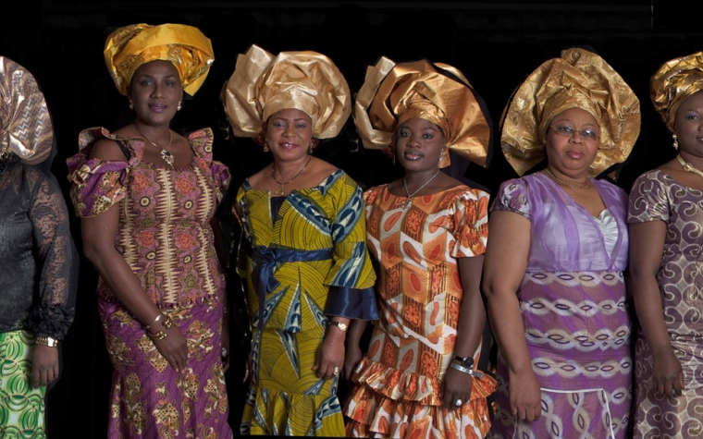
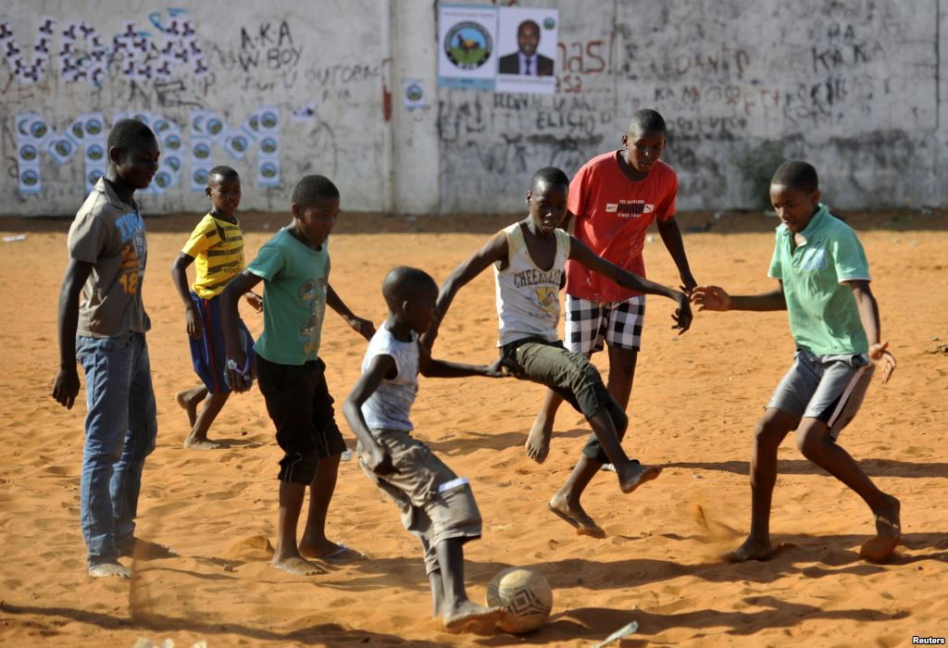
Society
English is the official language but many indigenous languages are spoken
There are more than 250 ethnic groups; the largest 3 are Hausa-Fulani, Yoruba, and Igbo
Major religions are Christianity and Islam
Soccer is the most popular sport
Notes:
Image of Yoruba women’s choir: http://jnight.org/DBimages/the-Yoruba-Women-Choir-10-female-singers-24.jpg
Image source of boys playing soccer: http://omgvoice.com/lifestyle/play-street-football/?geoip&country=GH

Slide 6
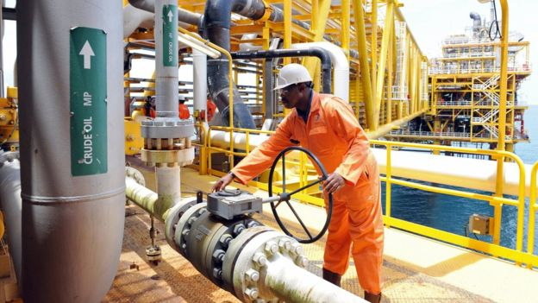
Economy
Nigeria has high levels of oil reserves (10th largest reserve in the world)
Exporting crude oil is central to the economy
85% of the government’s revenue comes from crude oil exports

Slide 7
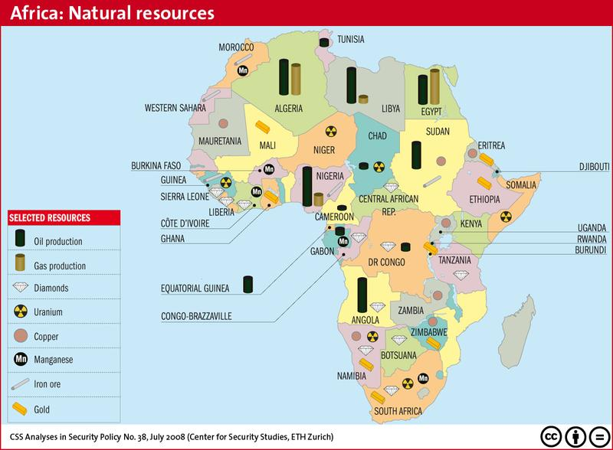
Notes:
Source: “British Imperialism in Nigeria,” https://tristenkoronye.wikispaces.com/British+Imperialism+in+Nigeria

Slide 8
Challenges
Poor healthcare
Poor living conditions
Lack of universal access to clean water
Life expectancy is on average 52 years
Because Nigeria does not have the means to refine the oil reserves, they rely on petroleum imports for energy needs

Slide 9
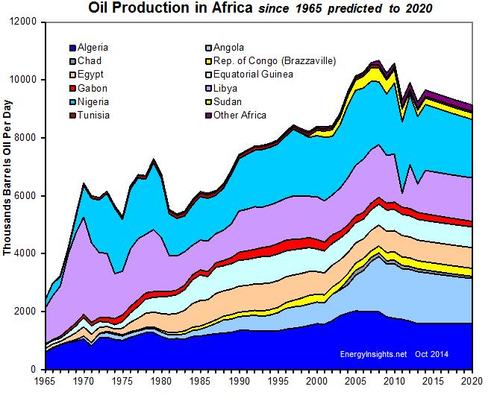

Slide 10
Oil workers (from the Shell company of Nigeria) returning home from work, caught in torrential rain
(2013)
Notes:
Source: https://collectordaily.com/david-claerbout-lightwork-sean-kelly/
The work is comprised of a color photograph of perhaps 40 men and boys standing beneath a concrete overpass. The title, Oil Workers (from the Shell company of Nigeria) returning home from work, caught in a torrential rain, locates the scene.
Claerbout found the image on the Internet and was struck that someone would have taken and posted a photo of anonymous workers patiently waiting out a storm. The crowd faces the camera. But with the use of 3D graphics, he has altered the perspective so the bodies of the men have solidity. As the camera weaves around the scene, characters appear or disappear from the edges of the frame. While this technique offers the illusion they are grounded in a particular space, it also mocks the impotence of their inaction by putting them at the mercy of a slippery and nosy computer program.

Slide 11
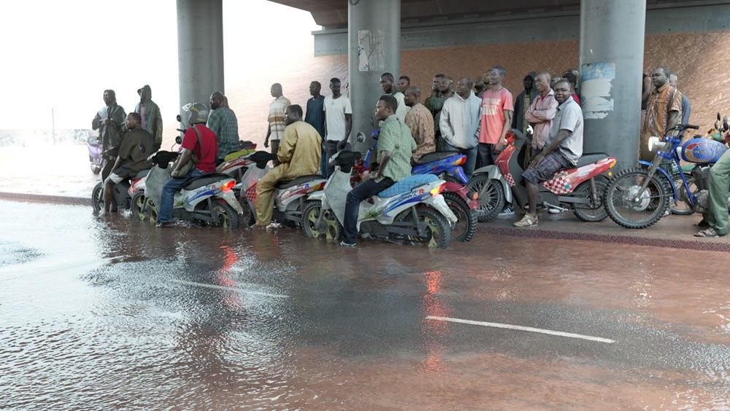
http://davidclaerbout.com/Oil-workers-from-the-Shell-company-of-Nigeria-returning-home-from
Notes:
Source: http://www.timothydixon.co.uk/am403piece.pdf
Claerbout’s Oil workers (from the Shell company of Nigeria) returning home from work, caught in torrential rain, 2013 --- The work presents a group of men gathered under a bridge in a downpour. The image was culled from the internet, the small JPEG then being reworked using 3D modelling software to give the photograph depth and movement as the camera pans across. Claerbout points to the conditions under which we operate: the image is archetypal of the globalised exploitation of labour in late capitalism. Workers paid little for their time, doing difficult, dangerous and exploitative work, caught in a moment’s pause that is extended out across minutes in the video work. Slowness must remain critical and avoid falling into a therapeutics that simply gives the viewer pause in order to return refreshed to the marketplace.

